Slide 1





School Rep Training 2026

Slide 2
Course Rep Training 2026
Notes:
Welcome to Course Rep Training for 2026

Slide 3
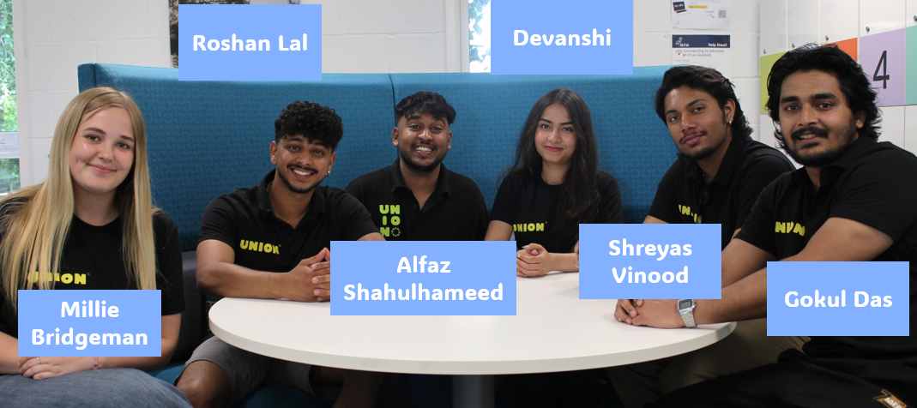
What is a Student Union?
Notes:
Every single student at ARU is automatically a member of the Student Union as soon as they start!
Each year the union is run by eight democratically elected officers

Slide 4
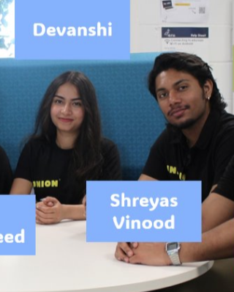
As Cambridge Course Reps you should be seeing:
Notes:
However for your roles as Cambridge Campus Course Reps you will probably be dealing most with
Education Officer
Cambridge Officer
The Officer team are elected members of staff whose whole job is to support YOU as students.
As Course Representatives they should be a constant contact in your role so reach out to them and say hello!

Slide 5

You're main staff contact as a rep will be your Representation Co-Ordinator – Tom!
These are full-time staff members whose job is to elect, train, and support Course Reps like yourself.
Notes:
The Representation Coordinator for the Cambridge Campus is Tom!
His job is to elect, train and support course reps throughout their year!
If you need any help in the role he is your guy!

Slide 6
What is a School Rep?
A School Rep represents all courses in their school. Their job is to gain feedback from all the course reps in their school and help make university change across the faculty and school: The schools on the cambridge camous are:
HeMS
School of Nursing
School of Midwifery, Allied Health and Social Care

Slide 7
What is a School Rep?
A School Rep represents all courses in their school. Their job is to gain feedback from all the course reps in their school and help make university change across the faculty and school: The schools on the cambridge camous are:
AHESS
School of Humanities
School of Art & Creative Industries
School of Education

Slide 8
What is a School Rep?
A School Rep represents all courses in their school. Their job is to gain feedback from all the course reps in their school and help make university change across the faculty and school: The schools on the cambridge camous are:
S&E
School of Computer and Information Sciences
School of Life Sciences
School of Psychology, Sport, and Sensory Sciences

Slide 9
What is a School Rep?
A School Rep represents all courses in their school. Their job is to gain feedback from all the course reps in their school and help make university change across the faculty and school: The schools on the cambridge camous are:
B&L
School of Economics, Law and Finance
School of Management

Slide 10

How do I get feedback?
Notes:
How to get feedback?
Getting feedback can be hard!
Students will rarely volunteer their feedback to you
You have to be proactive in getting it yourself.
How you do this is up to you many cohorts respond differently to certain things. Here are a few examples you might want to try

Slide 11
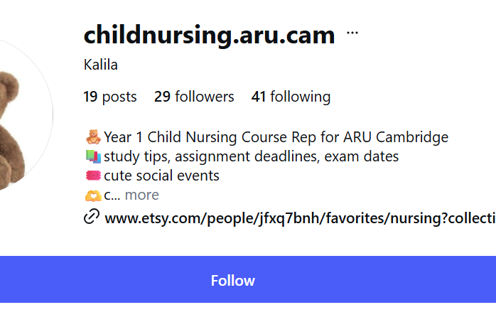



Social Media
Notes:
Social Media can be really helpful tool in getting feedback
In the past reps have used whatsapp and messenger group chats – although its important to make sure everyone is added
Linkedin can be a great tool to use for networking
Last year our child nursing course rep set up a special instagram page to post updates and get feedback!

Slide 12
Surveys
Ask open questions:
“What did you think of that assessment?”
“Do you think this module guide makes sense?”
“How do you find the classrooms here?”
There are various options for free, online surveys including:
Google forms
Microsoft Forms
Notes:
Online surveys are an easy way of getting feedback and organising the data you receive

Slide 13
Surveys
Ask open questions:
“What did you think of that assessment?”
“Do you think this module guide makes sense?”
“How do you find the classrooms here?”
There are various options for free, online surveys including:
Google forms
Microsoft Forms
Notes:
Your cohort will probably not volunteer their feedback to you. You have to be proactive.
If you're struggling to get this asking open questions like this can help oil the cogs!

Slide 14


How to talk to Course Reps?
Join the WhatsApp channels
Access their emails from SharePoint

Slide 15
How to talk to Course Reps?
Join the WhatsApp channels
Host a social event for them
Remember to ask your rep coordinator to help make these connections!
Access their emails from Sharepoint

Slide 16
How to talk to Course Reps?
Join the WhatsApp channels
Host a social event for them
Remember to ask your rep coordinator to help make these connections!
Access their emails from Sharepoint

Slide 17
How to talk to Course Reps?
Join the WhatsApp channels
Host a social event for them
Remember to ask your rep coordinator to help make these connections!
Access their emails from Sharepoint

Slide 18
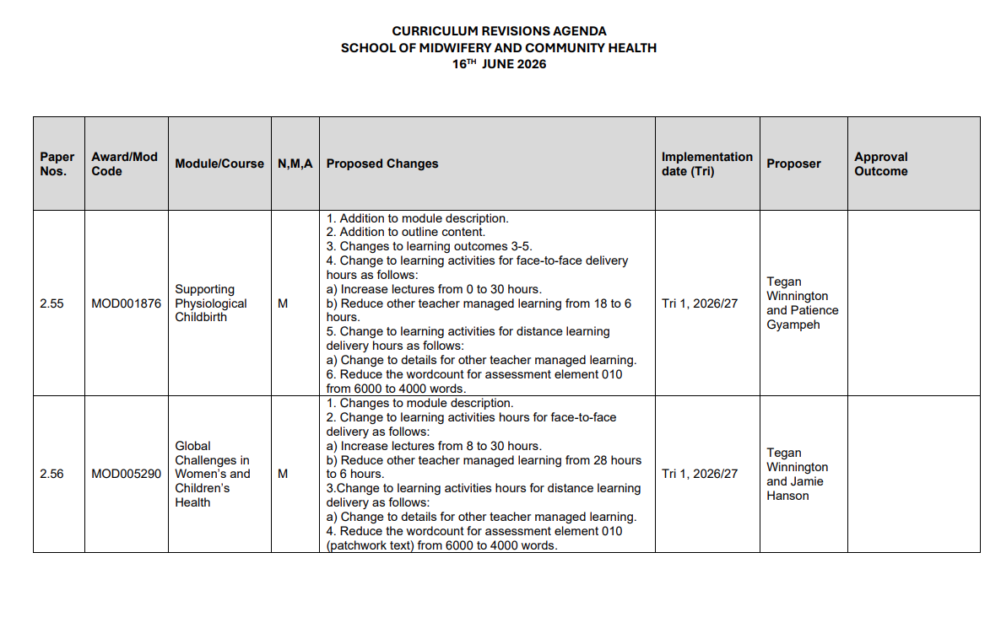
Curriculum Revisions
Around once every trimester your school will run Curriculum Revisions.
They will present a document that looks like this
The revision could be anything from small name changes to larger changes to assesments etc

Slide 19
Curriculum Revisions
School Reps will be part of their Campus Council.
This will involve meeting regularly with the Campus Officer to work on campaigns, form policies, and decide on campus stances.
You will receive full training on this from the Democracy Development Coordinator.
Active members of the Campus Council will also have the chance to be part of the Union Executive, the top decision-making body of the Union.

Slide 20
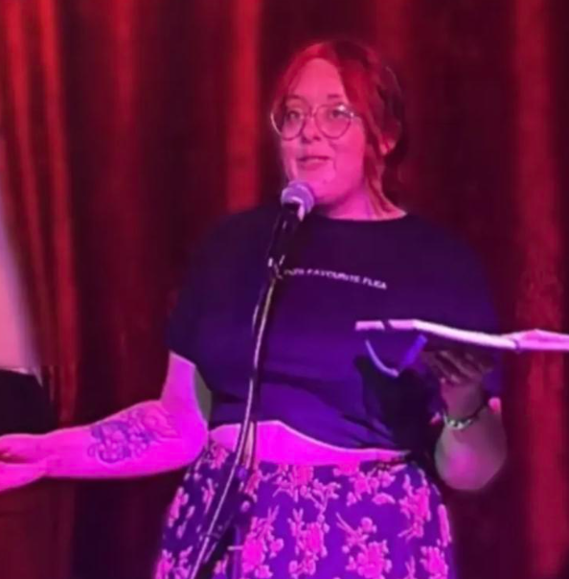
Campus Councils ​
Your input as the voice of the student body is VITAL to these discussions
Prior to each curriculum revision you will have a briefing with the rep coordinator to discuss your responses!
Campus Councils are arranged by Demi Smith
Democracy Development Coordinator
She/They
Demi.smith@angliastudent.com

Slide 21

What is a campaign?
A campaign is where students organise to improve conditions at the university, or in their local community, on a wide variety of issues, be that in academics like getting class sizes reduced, or tackling social issues which exist across society like racism.
Notes:
Some feedback can lead to more substantial societal change. This can mean you have a campaign idea:
WHAT IS A CAMPAIGN?
A campaign is where students organise to improve conditions at the university, or in their local community, on a wide variety of issues, be that in academics like getting class sizes reduced, or tackling social issues which exist across society like racism.

Slide 22
Does campaigning work?
Absolutely, at ARU and across the UK, students have won…
Class size reductions from 400 to 100 students in FBL
Keeping Wednesday Afternoon Free for undergraduates
Reintroduction of maintenance grants
And much more
Notes:
Some feedback can lead to more substantial societal change. This can mean you have a campaign idea:
WHAT IS A CAMPAIGN?
A campaign is where students organise to improve conditions at the university, or in their local community, on a wide variety of issues, be that in academics like getting class sizes reduced, or tackling social issues which exist across society like racism.

Slide 23

Your Liberation & Campaigns Coordinator – Jo Bunkle
The Union’s Liberation & Campaigns Coordinator is there to give you advice, boost your confidence and expand your horizons as an activist.
Jo has been working with student campaigners for years, and has insight into making change in, and outside ARU.
Jo Bunkle
Campaigns Coordinator
She/They
j.bunkle@angliastudent.com
Notes:
Some feedback can lead to more substantial societal change. This can mean you have a campaign idea:
WHAT IS A CAMPAIGN?
A campaign is where students organise to improve conditions at the university, or in their local community, on a wide variety of issues, be that in academics like getting class sizes reduced, or tackling social issues which exist across society like racism.

Slide 24
School Forums ​
Once a trimester we would expect a school rep to take the lead in organising a School Forum for the students in their school. This can be done any way you like.
In the past they have:
Been evening events with pizza and drink
Lunch time with tea, coffee and cake
Remember to chat to your rep coordinator about your thoughts and get the first date in the diary.
Notes:
Some feedback can lead to more substantial societal change. This can mean you have a campaign idea:
WHAT IS A CAMPAIGN?
A campaign is where students organise to improve conditions at the university, or in their local community, on a wide variety of issues, be that in academics like getting class sizes reduced, or tackling social issues which exist across society like racism.

Slide 25
Congratulations on finishing training: What's Next?
Join the Course Rep Whatsapp group
Claim you're School Rep Freebies
Check out the Rep Hub on the Student Union website
Tell your cohort who you are!
Think about booking your first School Forum

