Slide 1

Safeguarding Training 2026

Slide 2
TYPES OF ABUSE:
FEEDBACK IS NOT:
Physical Abuse
Intentional physical harm or injury
Emotional Abuse
Psychological harm and manipulation
Sexual Abuse
Non-consensual sexual acts or coercion
Financial Abuse
Illegal or unauthorized use of resources
Discriminatory Abuse
Harassment based on protected characteristics
THIS IS NOT AN EXHAUSTIVE LIST BUT A START
A chance to just complain
A way to raise personal matters
A way to further individual issues
A chance to name and shame someone

Slide 3
FEEDBACK IS:
ABUSE STATS IN UNIVERSITY GROUPS:
Solution focused
Based on consensus
Can be praise
Can be a new idea
Can be critical
Should be constructive
Could be a mix of positive and negative
Understanding the prevalence of abuse helps us recognize its impact:
•1 in 4 women and 1 in 6 men experience domestic abuse in their lifetime
•Students from minority backgrounds may face additional challenges
•Many cases go unreported due to fear, shame, or lack of awareness

Slide 4
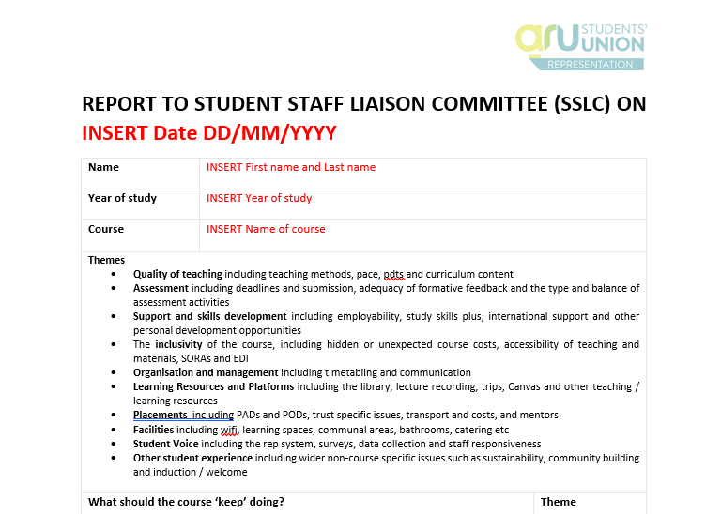
Protected Characteristics
The Equality Act 2010 protects individuals from discrimination based on:
Age
Disability
Gender Reassignment
Marriage & Civil Partnership
Pregnancy & Maternity
Race
Religion or Belief
Sex
Sexual Orientation
As a Course Rep: You must be aware of these characteristics and ensure all students are treated fairly and with respect.

Slide 5
How to safeguard appropriately...
LISTEN WITHOUT JUDGEMENT
Take all disclosures seriously and believe what you are told
MAINTAIN CONFIDENTIALLY
Only share information with appropriate safeguarding personnel
DON'T INVESTIGATE
Your role is to listen and refer, not to investigate the situation.
DOCUMENT ACCURATELY
Record what was said using the person's own words where possible
ACT PROMPTLY
Report concerns quickly to designated safeguarding officers
Notes:
Don’t forget to give examples!

Slide 6

Signposting
SU Advice
Study Skills+
Money Advice
Exceptional Circumstances
Complaints
Academic offences
Assignment help
Skills workshops
Tuition fees
Living costs
Banks and savings
iCentre
Counselling & Wellbeing
Mitigation
Withdrawal
Timetable changes
Mental health
Emotional support
Notes:
Don’t forget to give examples!

Slide 7
Signposting
International Office
Employability
Disability & Dyslexia Service
Visa questions
Expenses
Visa advice
Graduate jobs
CV building
Volunteer work
Accessibility
Additional benefits
Reasonable adjustments
If you’re ever in doubt, reach out to your Rep Coordinator!
Notes:
Don’t forget to give examples!

Slide 8




External Support Services
If students or reps need additional support, these external charities and organizations can help:
Samaritans
24/7 emotional support - Call 116 123
National Domestic Abuse Helpline
24/7 support - Call 0808 2000 247
Rape Crisis
Support for survivors - 0808 802 9999
MIND
Mental health support - 0300 123 3393
Childline (for under 19s)
Free confidential support - 0800 1111
IN EMERGENCIES – ALWAYS CALL 999

