Slide 1





Course Rep Training 2026
Notes:
Welcome to Course Rep Training for 2026

Slide 2
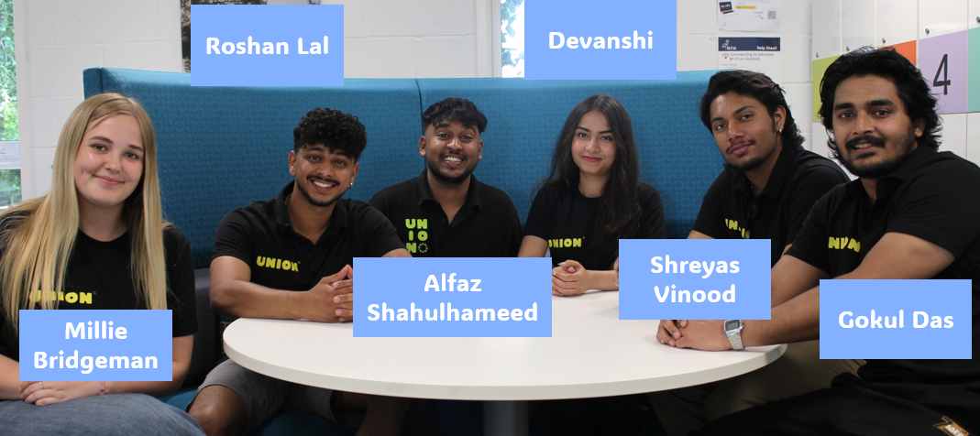
What is a Student Union?
Notes:
Every single student at ARU is automatically a member of the Student Union as soon as they start!
Each year the union is run by eight democratically elected officers

Slide 3

Your main staff contact as a rep will be your Representation Co-Ordinator – Nicola. You can contact Nicola via Chelmsford.reps@arunion.co.uk
These are full-time staff members whose job is to elect, train, and support Course Reps like yourself.
Notes:
The Representation CoYordinator for the Cambridge Campus is Tom!
His job is to elect, train and support course reps throughout their year!
If you need any help in the role he is your guy!

Slide 4

What is a course rep?
Each course has at least one course rep per year of study.
Notes:
So, What is a Course Rep?
Each course has at least one course rep per year of study

Slide 5
What is a course rep?
Their job is to gather feedback about all aspects of the student experience at ARU and deliver that feedback to relevant staff.
Notes:
Their job is to gather feedback on all aspects of student life at ARU.
This could include:
Academics
Assesments
Events
Facilities and much more

Slide 6
What is a course rep?
The Students Union can help you use that feedback and make positive change at ARU!
Notes:
Once you have gained that feedback the Union can help you to use it to make positive change at ARU
This could be big or small changes but all change matters

Slide 7

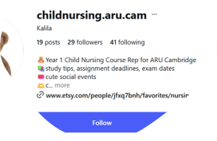

How do I get feedback?
Use Social Media
Notes:
How to get feedback?
Getting feedback can be hard!
Students will rarely volunteer their feedback to you
You have to be proactive in getting it yourself.
How you do this is up to you many cohorts respond differently to certain things. Here are a few examples you might want to try

Slide 8

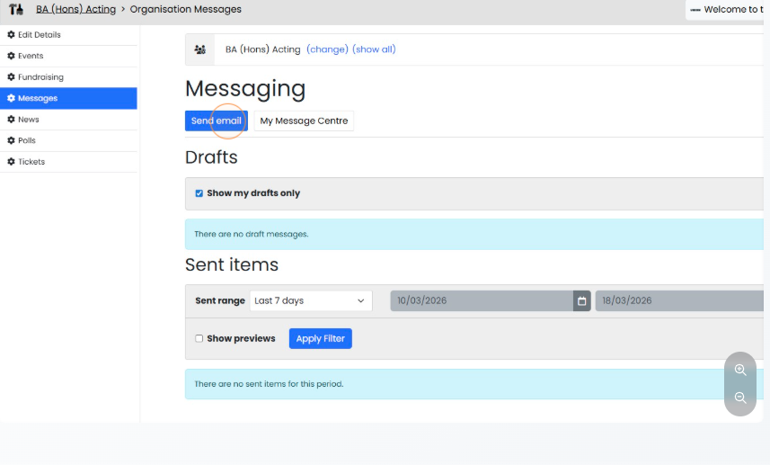
Email your cohort Via THE REP HUB
https://arunion.co.uk/chelmsford/your-say/representation/messaging-centre/
Notes:
Via the Rep Hub you can use the EMAIL ALL function to automatically send an email to all student addresses of your cohort

Slide 9

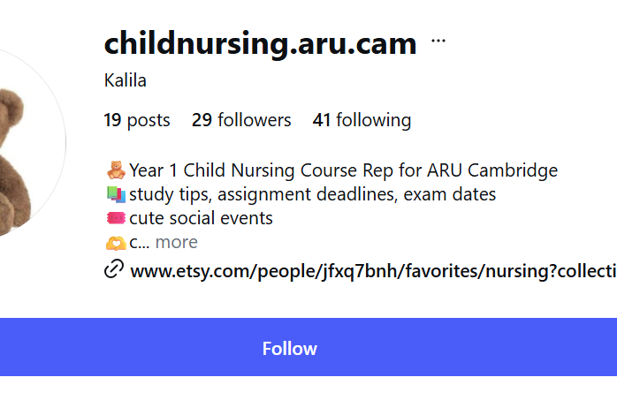


There are various options for free, online surveys including:
Google forms
Microsoft Forms
Surveys
Ask open questions:
“What did you think of that assessment?”
“Do you think this module guide makes sense?”
“Can you find all the resources you need on Canvas ?”
Social Media
Notes:
Social Media can be really helpful tool in getting feedback
In the past reps have used whatsapp and messenger group chats – although its important to make sure everyone is added
Linkedin can be a great tool to use for networking
Last year our child nursing course rep set up a special instagram page to post updates and get feedback!

Slide 10
You can also collect feedback in person.
In person meetings
This can be by having informal chats and discussions with your course mates or asking the lecturer to allow you 15 minutes at the end of a lecture to gather feedback.
Social Media
Notes:
Social Media can be really helpful tool in getting feedback
In the past reps have used whatsapp and messenger group chats – although its important to make sure everyone is added
Linkedin can be a great tool to use for networking
Last year our child nursing course rep set up a special instagram page to post updates and get feedback!

Slide 11
Where Should You Take Feedback?
If you're getting feedback that is small and easily fixable (ie things that could be resolved by sending an email) that it's worth getting on it as soon as possible. This could be things like:
Canvas not being updated
Facilities issues
Tech difficulties
SMALL
Notes:
If you're getting feedback that is small and easily fixable (ie things that could be resolved by sending an email) that it's worth getting on it as soon as possible. This could be things like:
Canvas not being updated
Facilities issues
Tech difficulties

Slide 12
Where Should You Take Feedback?
For unresolved issues or something that needs more discussion, you should take these to your Student Staff Liaison Committee (SSLCs).​
​e.g. “A lot of students on this course are commuters; can we take this into consideration for TRI2 timetables?”
UNRESOLVED
Notes:
If you're getting feedback that is small and easily fixable (ie things that could be resolved by sending an email) that it's worth getting on it as soon as possible. This could be things like:
Canvas not being updated
Facilities issues
Tech difficulties

Slide 13


What is an SSLC?
SSLC stands for Student Staff Liaison Committee:
They happen once a trimester
Engagement with the SSLC is mandatory for ALL course reps
You can send a report with your feedback if you aren't able to attend
Notes:
SSLC stands for Student Staff Lliason Committee: and it is your opportunity to raise the feedback that is not an easy fix or needs more discussion.
They happen once a trimester and you will receive an email invite by the admin of you school
Engagement with the SSLC is mandatory for ALL course reps
If you are unable to attend the meeting in person you can send a report with your feedback so it can be discussed in your absence!

Slide 14
What is an SSLC?
SSLC stands for Student Staff Liaison Committee:
They happen once a trimester
Engagement with the SSLC is mandatory for ALL course reps
You can send a report with your feedback if you aren't able to attend
Notes:
SSLC stands for Student Staff Lliason Committee: and it is your opportunity to raise the feedback that is not an easy fix or needs more discussion.
They happen once a trimester and you will receive an email invite by the admin of you school
Engagement with the SSLC is mandatory for ALL course reps
If you are unable to attend the meeting in person you can send a report with your feedback so it can be discussed in your absence!

Slide 15
What is an SSLC?
SSLC stands for Student Staff Liaison Committee:
They happen once a trimester
Engagement with the SSLC is mandatory for ALL course reps
You can send a report with your feedback if you aren't able to attend
Notes:
SSLC stands for Student Staff Lliason Committee: and it is your opportunity to raise the feedback that is not an easy fix or needs more discussion.
They happen once a trimester and you will receive an email invite by the admin of you school
Engagement with the SSLC is mandatory for ALL course reps
If you are unable to attend the meeting in person you can send a report with your feedback so it can be discussed in your absence!

Slide 16
What is an SSLC?
SSLC-student-report-template1.docx
SSLC stands for Student Staff Liaison Committee:
They happen once a trimester
Engagement with the SSLC is mandatory for ALL course reps
You can send a report with your feedback if you aren't able to attend
Notes:
SSLC stands for Student Staff Lliason Committee: and it is your opportunity to raise the feedback that is not an easy fix or needs more discussion.
They happen once a trimester and you will receive an email invite by the admin of you school
Engagement with the SSLC is mandatory for ALL course reps
If you are unable to attend the meeting in person you can send a report with your feedback so it can be discussed in your absence!

Slide 17
Keep, Stop, Start
FEEDBACK IS:
FEEDBACK IS NOT:
Solution focused
Based on consensus
Can be praise
Can be a new idea
Can be critical
Should be constructive
Could be a mix of positive and negative
A chance to just complain
A way to raise personal matters
A way to further individual issues
A chance to name and shame someone
Keep
Things students like and would like to continue.
Stop
Things students find detrimental and would like to cease.
Start
New ideas that students would like to see implemented.
Notes:
At the SSLC you will be asked to present your feedback in a Keep, Stop, Start format
KEEP – Things you like from the university
STOP – Stuff that is negatively affecting your student experience
START – New ideas and suggestions to improve the student experience

Slide 18
Where Should You Take Feedback?
For feedback that isn’t resolved in your SSLC and is still ongoing, or is affecting multiple courses you can take this to your school rep, student officer, rep coordinators or other Union staff. They will be able to escalate it to higher level meetings and staff.
Rep co-ordinators can help connect you with the relevant staff for your issue and sit in meetings with you and staff to support you in your delivery.
School reps can take actions specific to your course and school to FEC’s e.g Issues with E-vision training affecting students across the school.
Student Officers can take actions that affect the wider student population to high level meetings with the vice-chancellors e.g library opening hours.
SMALL
Notes:
If you're getting feedback that is small and easily fixable (ie things that could be resolved by sending an email) that it's worth getting on it as soon as possible. This could be things like:
Canvas not being updated
Facilities issues
Tech difficulties

Slide 19


For issues that are bigger than your course and have wider implications for all university students
e.g. Rent is too high in Student Accommodation, or food is too expensive on campus.
You could help start a campaign!
Big Picture

Slide 20

What is a campaign?
A campaign is where students organise to improve conditions at the university, or in their local community, on a wide variety of issues.
Notes:
Some feedback can lead to more substantial societal change. This can mean you have a campaign idea:
WHAT IS A CAMPAIGN?
A campaign is where students organise to improve conditions at the university, or in their local community, on a wide variety of issues, be that in academics like getting class sizes reduced, or tackling social issues which exist across society like racism.

Slide 21
Does campaigning work?
Absolutely, at ARU and across the UK, students have won…
Class size reductions from 400 to 100 students in FBL
Keeping Wednesday Afternoon Free for undergraduates
Reintroduction of maintenance grants
And much more
Notes:
bsolutely, at ARU and across the UK, students have won…
Class size reductions from 400 to 100 students in FBL
Keeping Wednesday Afternoon Free for undergraduates
Reintroduction of maintenance grants
And much more

Slide 22

Your Liberation & Campaigns Coordinator – Jo Bunkle
The Union’s Liberation & Campaigns Coordinator is there to give you advice, boost your confidence and expand your horizons as an activist.
Jo has been working with student campaigners for years, and has insight into making change in, and outside ARU.
Jo Bunkle
Campaigns Coordinator
She/They
j.bunkle@angliastudent.com
Notes:
The Union’s Liberation & Campaigns Coordinator is there to give you advice, boost your confidence and expand your horizons as an activist.
Jo has been working with student campaigners for years, and has insight into making change in, and outside ARU.

Slide 23
Closing the Feedback loop
Wherever you take your feedback and however small or big it is, remember to close the feedback loop.
This means reporting back to your coursemates the outcome of the feedback.
e.g. If you report to an SSLC that students are having issues with the timetabling and the faculty says they will report it to the timetabling team to try and fix it next term. You should send out communication to your course mates that this is happening, so they can stay in the loop.

Slide 24
Signposting
SU Advice
Study Skills+
Money Advice
Exceptional Circumstances
Complaints
Academic offences
Assignment help
Skills workshops
Tuition fees
Living costs
Banks and savings
iCentre
Counselling & Wellbeing
Mitigation
Withdrawal
Timetable changes
Mental health
Emotional support
Notes:
It is likely as the course representative you may be one of the first people students think off when they need help. Although we would not expect you to know everything we would ecpect you to help signpost to some of the many support system on offer from both the uni and union

Slide 25
Signposting
International Office
Employability
Disability & Dyslexia Service
Visa questions
Expenses
Visa advice
Graduate jobs
CV building
Volunteer work
Accessibility
Additional benefits
Reasonable adjustments
If you’re ever in doubt, reach out to your Rep Coordinator!
Notes:
Don’t forget to give examples!

Slide 26
You Should Not…
SIT ON DISCIPLINARY OR APPEALS PANELS
DEAL WITH STUDENTS’ PERSONAL ISSUES
REPRESENT STUDENTS AT ARU COMMITTEES
HELP STUDENTS WITH PERSONAL FORMAL PROCESSES
TAKE PART IN SURVEYS AND FORUMS
REPRESENT OTHER COURSES
HELP GET NEW COURSES APPROVED
MAKE ON THE SPOT DECISIONS ON BEHALF OF STUDENTS
START A COURSE BASED SOCIETY
WAIT FOR STUDENTS TO GET IN TOUCH
CO-CHAIR MEETINGS
PRIORITISE YOUR REP ROLE OVER YOUR STUDUES

Slide 27
Celebrating your rep wins
At Union we want to celebrate the work our reps do, big or small, so if you have successfully made change let us know!
Whether you got lecture recordings posted on Canvas or you’ve made improvements to timetabling for your course, we want to know.
This year we are looking to shout out the hard work of reps via LinkedIn and our other social media channels, but we can’t do this if we don’t know what you are doing so please stay in touch.

Slide 28
Other opportunities...
As a course rep you will also have access to the following:
Course Approval Panels
Academic Misconduct Panels
Co-chairing SSLC's with the faculty chair
Take part in forums and surveys from both the uni and the union
Run an event or project with our Make It Happen team https://arunion.co.uk/chelmsford/your-say/makeithappen/
Campaigning
Join or start a course based society. https://arunion.co.uk/chelmsford/get-involved/societies/
These opportunities are awarded in a variety of ways and will come to your emails so read them!
Notes:
Don’t forget to give examples!

Slide 29
Volunteering hours
As a course rep you are a volunteer for the Union and whilst completing your duties as a rep and any extra opportunities you may take on, you will accumulate some volunteering hours.
You should log these hours on our volunteering portal: https://arunion.co.uk/chelmsford/get-involved/volunteering/log-hours/
Through this you can generate a transcript of all the hours you spent as a course rep which you can use for portfolio’s, applications or your CV.
These hours are carried over throughout all your years at university and once you hit a milestone you can also ask to generate a certificate. 75 hours gets you a Bronze certificate, 150 for Silver, 250 for Gold and 400 for Platinum.
You can also log this hour of training on there, so don’t forget to do so after this session!
Notes:
Don’t forget to give examples!

Slide 30
Congratulations on finishing training: What's Next?
Collect your Course Rep lanyard
Put your digital course rep badge in your email signature
Check out the Rep Hub on the Student Union website https://arunion.co.uk/chelmsford/your-say/representation/
Tell your cohort who you are!
Find out who your school rep is here: https://arunion.co.uk/chelmsford/get-involved/representation/
Log your volunteer hour for this session!

