Slide 1





PGR Rep Training 2026

Slide 2
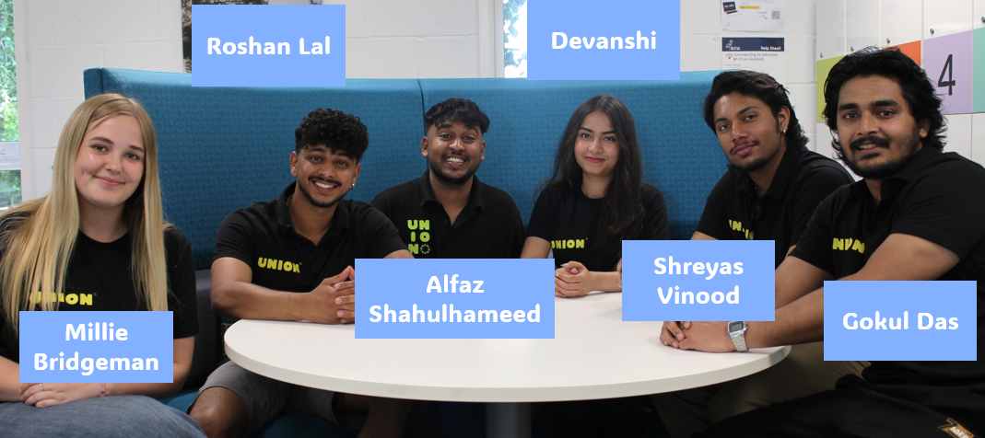
What is a Student Union?
Notes:
Every single student at ARU is automatically a member of the Student Union as soon as they start!
Each year the union is run by eight democratically elected officers

Slide 3
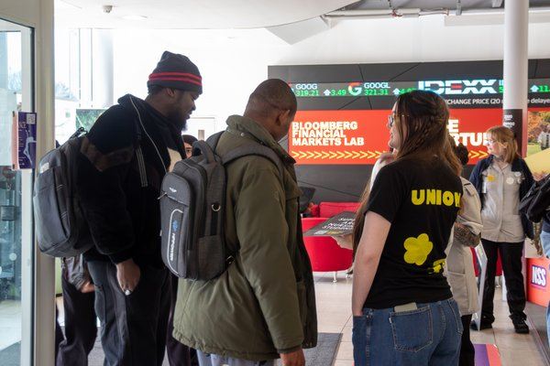
What is a PGR Rep?
The role of a PGR Rep is to collect feedback from the students in their cohort about their academic experience and deliver that feedback to staff who can help facilitate improvements.

Slide 4

What will my role look like?
Gathering feedback from PGR students
Attending faculty research & innovation committee (FRIC
meetings)
Delivering student feedback to relevant staff
Tracking the progress of feedback
Attending doctoral school meet ups
Signposting students to support services
Checking SU emails regularly

Slide 5
Your main staff contact as a rep for any rep related queries will be your Representation Co-Ordinator- To get in touch with them please contact Chelmsford.reps@arunion.co.uk
These are full-time staff members whose job is to elect, train, and support Course Reps like yourself.
Notes:
The Representation Coordinator for the Cambridge Campus is Tom!
His job is to elect, train and support course reps throughout their year!
If you need any help in the role he is your guy!

Slide 6
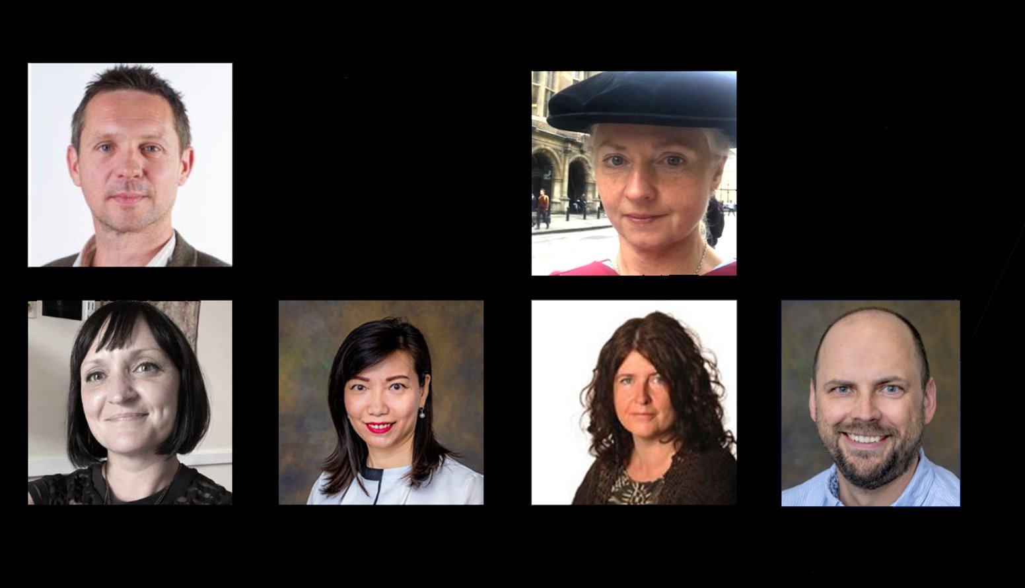
Whose who at ARU
Dr. Charlie Nevison
Assistant Director of the Doctoral School
Prof. John Gardner
Dean of the Doctoral School
Dr. Tina Kendall
AHESS
Dr. Ying Wang
FBL
Dr. Sarah Burch
HeMS
Prof. Nick Pugh
FSE

Slide 7





How do I get feedback?
You can get feedback in a variety of ways; you should reach out to students in your cohort and find out what works for them
Remember to ask your rep coordinator if you need help making these connections!
Email your cohort via the Messaging Centre
How do I get feedback?
Use Social Media
Notes:
How to get feedback?
Getting feedback can be hard!
Students will rarely volunteer their feedback to you
You have to be proactive in getting it yourself.
How you do this is up to you many cohorts respond differently to certain things. Here are a few examples you might want to try

Slide 8
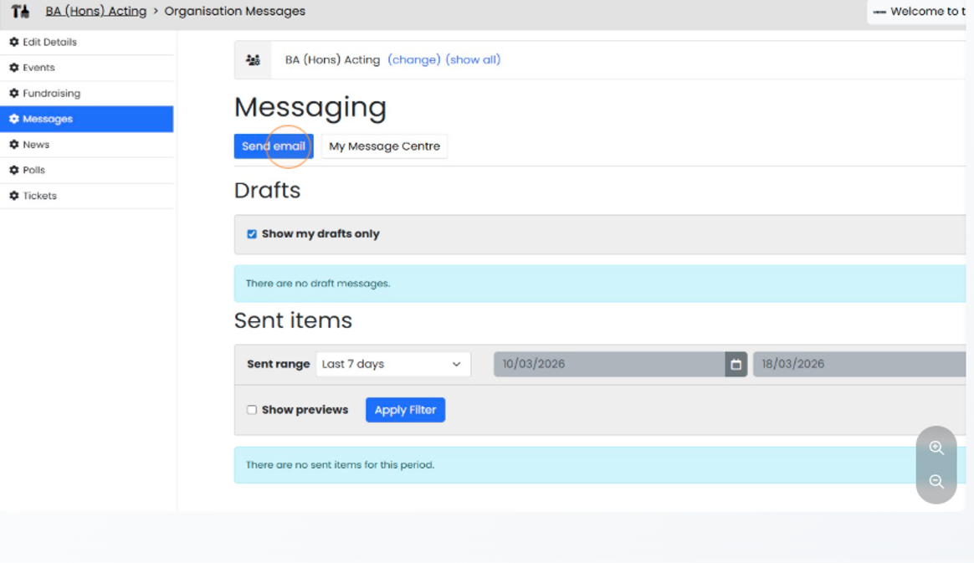
How to use the Messaging Centre?
https://arunion.co.uk/messagecentre/
https://arunion.co.uk/chelmsford/your-say/representation/messaging-centre/ Here is a guide on how to use it
The Messaging Centre is part of our Union website and allows course and PGR reps to talk to their cohort and School reps to talk to Course rep and PGR reps

Slide 9
Where Should You Take Feedback?
If you're getting feedback that is small and easily fixable (ie things that could be resolved by sending an email) that it's worth getting on it as soon as possible. This could be things like:
Canvas not being updated
Facilities issues
Tech difficulties
SMALL
Notes:
If you're getting feedback that is small and easily fixable (ie things that could be resolved by sending an email) that it's worth getting on it as soon as possible. This could be things like:
Canvas not being updated
Facilities issues
Tech difficulties

Slide 10
Where Should You Take Feedback?
For unresolved issues or something that needs more discussion, you should take these to your FRIC
​e.g. “The content on Progress Platform is not being updated”
UNRESOLVED
Notes:
If you're getting feedback that is small and easily fixable (ie things that could be resolved by sending an email) that it's worth getting on it as soon as possible. This could be things like:
Canvas not being updated
Facilities issues
Tech difficulties

Slide 11
Faculty Research Innovation Committee
Faculty Research and Innovation Committees are meetings that occur once a trimester between university staff and PGRs within your faculty. You'll receive an invitation in your outlook calendar and the meeting will usually be on Teams.
Please confirm your attendance to these meetings,and go to them even if you feel you don't have any feedback to share. You are an invaluable part of the conversation. It can't happen without you!
The purpose of a FRIC is:
1. Promoting and embedding a research culture to support colleagues and postgraduate
research students.
2. Supporting ARU’s Research & Innovation Strategy through the development & review of Faculty
Research & Innovation Strategy.
3. Monitoring and evaluating the quality and volume of research and innovation activity within the Faculty.
4. Student Matters- this is the space to give the feedback you have collected

Slide 12
Where Should You Take Feedback?
For feedback that isn’t resolved in your FRIC, or you think needs to be escalated, you can take this to a student officer, rep coordinators or other Union staff. They will be able to escalate it to higher level meetings and staff.
Rep co-ordinators can help connect you with the relevant staff for your issue and sit in meetings with you and staff to support you in your delivery.
Student Officers can take actions that affect the wider student population to high level meetings with the vice-chancellors e.g library opening hours.
Notes:
If you're getting feedback that is small and easily fixable (ie things that could be resolved by sending an email) that it's worth getting on it as soon as possible. This could be things like:
Canvas not being updated
Facilities issues
Tech difficulties

Slide 13


For issues that are bigger than your course and have wider implications for all university students
e.g. Rent is too high in Student Accommodation, or food is too expensive on campus.
You could help start a campaign!
Big Picture

Slide 14

What is a campaign?
A campaign is where students organise to improve conditions at the university, or in their local community, on a wide variety of issues, be that in academics like getting class sizes reduced, or tackling social issues which exist across society like racism.
Notes:
Some feedback can lead to more substantial societal change. This can mean you have a campaign idea:
WHAT IS A CAMPAIGN?
A campaign is where students organise to improve conditions at the university, or in their local community, on a wide variety of issues, be that in academics like getting class sizes reduced, or tackling social issues which exist across society like racism.

Slide 15
Does campaigning work?
Absolutely, at ARU and across the UK, students have won…
Class size reductions from 400 to 100 students in FBL
Keeping Wednesday Afternoon Free for undergraduates
Reintroduction of maintenance grants
And much more
Notes:
Some feedback can lead to more substantial societal change. This can mean you have a campaign idea:
WHAT IS A CAMPAIGN?
A campaign is where students organise to improve conditions at the university, or in their local community, on a wide variety of issues, be that in academics like getting class sizes reduced, or tackling social issues which exist across society like racism.

Slide 16
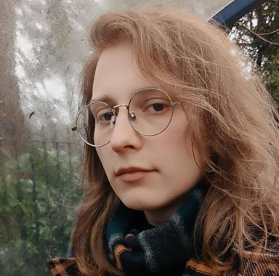
Your Liberation & Campaigns Coordinator – Jo Bunkle
The Union’s Liberation & Campaigns Coordinator is there to give you advice, boost your confidence and expand your horizons as an activist.
Jo has been working with student campaigners for years, and has insight into making change in, and outside ARU.
Jo Bunkle
Campaigns Coordinator
She/They
j.bunkle@angliastudent.com
Notes:
Some feedback can lead to more substantial societal change. This can mean you have a campaign idea:
WHAT IS A CAMPAIGN?
A campaign is where students organise to improve conditions at the university, or in their local community, on a wide variety of issues, be that in academics like getting class sizes reduced, or tackling social issues which exist across society like racism.

Slide 17
Closing the Feedback loop
Wherever you take your feedback and however small or big it is, remember to close the feedback loop.
This means reporting back to your coursemates the outcome of the feedback.
e.g. If you report to an SSLC that students are having issues with the timetabling and the faculty says they will report it to the timetabling team to try and fix it next term. You should send out communication to your course mates that this is happening, so they can stay in the loop.

Slide 18
Signposting
SU Advice
Study Skills+
Money Advice
Exceptional Circumstances
Complaints
Academic offences
Assignment help
Skills workshops
Tuition fees
Living costs
Banks and savings
iCentre
Counselling & Wellbeing
Mitigation
Withdrawal
Timetable changes
Mental health
Emotional support
Notes:
It is likely as the course representative you may be one of the first people students think off when they need help. Although we would not expect you to know everything we would ecpect you to help signpost to some of the many support system on offer from both the uni and union

Slide 19
Signposting
International Office
Employability
Disability & Dyslexia Service
Visa questions
Expenses
Visa advice
Graduate jobs
CV building
Volunteer work
Accessibility
Additional benefits
Reasonable adjustments
If you’re ever in doubt, reach out to your Rep Coordinator!
Notes:
Don’t forget to give examples!

Slide 20
You Should Not…
SIT ON DISCIPLINARY OR APPEALS PANELS
DEAL WITH STUDENTS’ PERSONAL ISSUES
REPRESENT STUDENTS AT ARU COMMITTEES
HELP STUDENTS WITH PERSONAL FORMAL PROCESSES
TAKE PART IN SURVEYS AND FORUMS
REPRESENT OTHER COURSES
HELP GET NEW COURSES APPROVED
MAKE ON THE SPOT DECISIONS ON BEHALF OF STUDENTS
START A COURSE BASED SOCIETY
WAIT FOR STUDENTS TO GET IN TOUCH
CO-CHAIR MEETINGS
PRIORITISE YOUR REP ROLE OVER YOUR STUDUES

Slide 21

Celebrating your rep wins
At Union we want to celebrate the work our reps do, big or small, so if you have successfully made change let us know!
Whether you got lecture recordings posted on Canvas or you’ve made improvements to timetabling for your course, we want to know.
This year we are looking to shout out the hard work of reps via LinkedIn and our other social media channels, but we can’t do this if we don’t know what you are doing so please stay in touch.

Slide 22
Other opportunities...
As a course rep you will also have access to the following:
Course Approval Panels
Academic Misconduct Panels
Other PGR Panels
Take part in forums and surveys from both the Uni and Union
Run an event or project with our Make It Happen team https://arunion.co.uk/chelmsford/your-say/makeithappen/
Campaigning
Join or start a course based society. https://arunion.co.uk/chelmsford/get-involved/societies/
These opportunities are awarded in a variety of ways and will come to your emails so read them!
Notes:
Don’t forget to give examples!

Slide 23
Congratulations on finishing training: What's Next?
Check out the Rep Hub on the Student Union website https://arunion.co.uk/chelmsford/your-say/representation/
Tell your cohort who you are!
Start gathering feedback from your cohort

