Slide 1





School Rep Training 2026

Slide 2
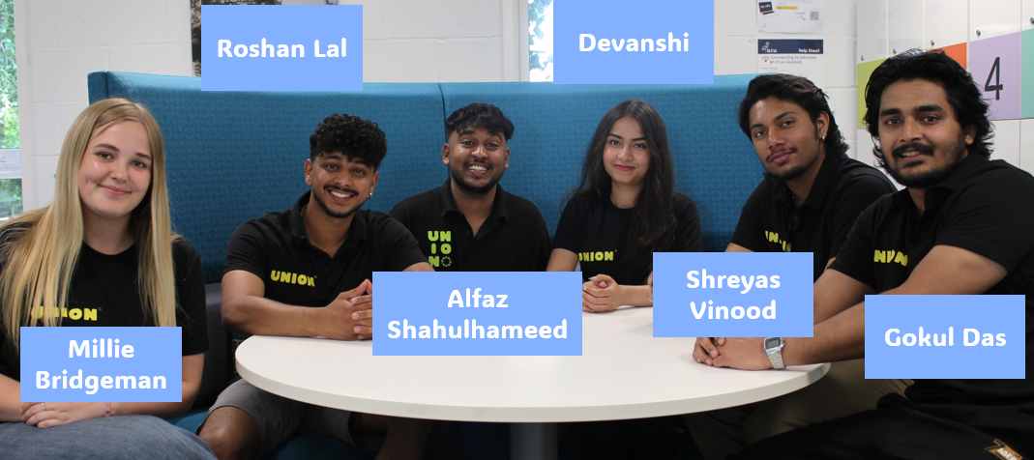
What is a Student Union?
Notes:
Every single student at ARU is automatically a member of the Student Union as soon as they start!
Each year the union is run by eight democratically elected officers

Slide 3
Your main staff contact as a rep will be your Representation Co-Ordinator – Nicola. You can contact Nicola via Chelmsford.reps@arunion.co.uk
These are full-time staff members whose job is to elect, train, and support Reps like yourself.
Notes:
The Representation Coordinator for the Cambridge Campus is Tom!
His job is to elect, train and support course reps throughout their year!
If you need any help in the role he is your guy!

Slide 4
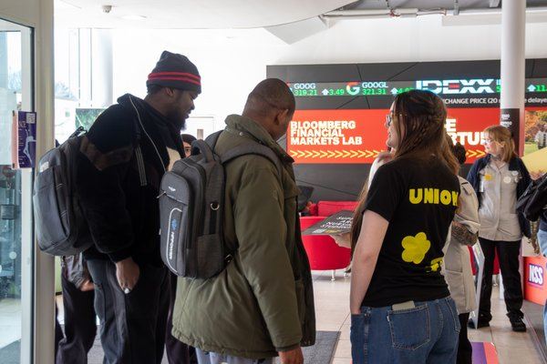
What is a School Rep?
A School Rep represents all courses in their school. Their job is to gain feedback from all the course reps in their school and help make university change across the faculty and school.

Slide 5

How to talk to Course Reps?
Contact them on teams!
Remember to ask your rep coordinator if you need help making these connections!
Host a social event to meet with them!
Email them via the Messaging Centre!

Slide 6
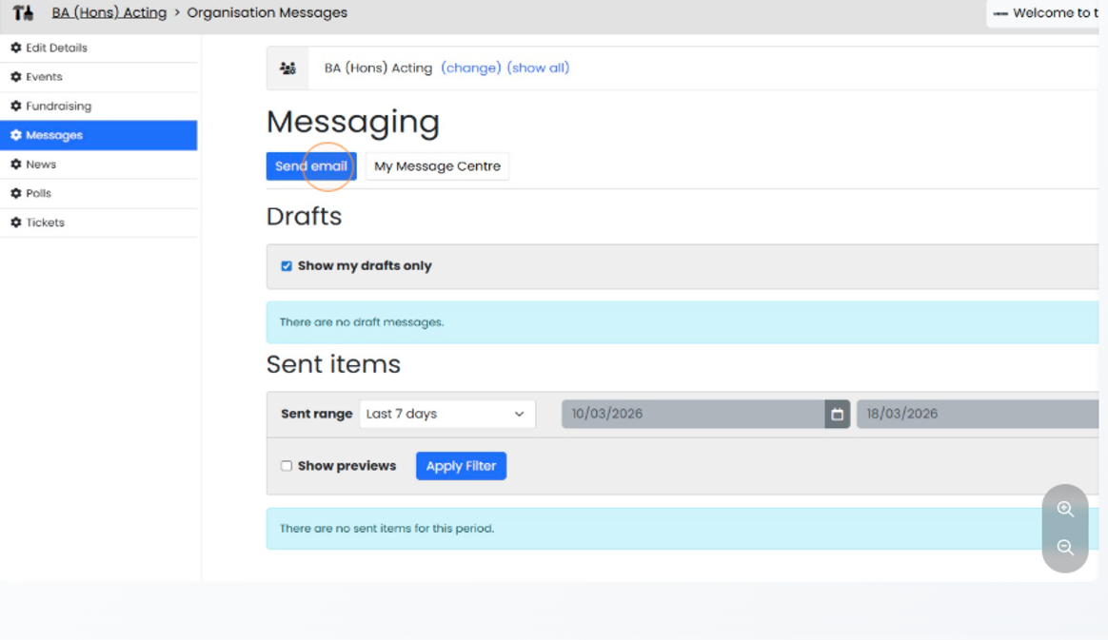
How to use the Messaging Centre?
https://arunion.co.uk/messagecentre/
https://arunion.co.uk/chelmsford/your-say/representation/messaging-centre/ Here is a guide on how to use it
The Messaging Centre is part of our Union website and allows Course reps to talk to their cohort and School reps to talk to Course reps.

Slide 7
Faculty Education Committees (FECs)
Around once every trimester your school will run FECs.
They are typically split into two parts.
They will discuss various topics, including ongoing feedback from SSLCs, MES results and Curriclum revisions.
You will be asked to attend a FEC if the content is relevant to your school or if you have an issue you wish to raise on behalf of your course reps

Slide 8
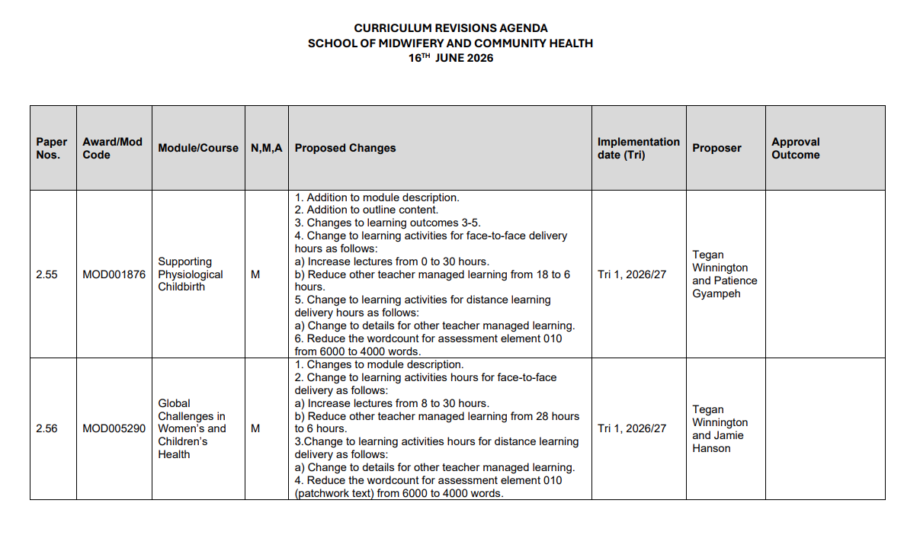
Curriculum Revisions
All FECs will have Curriculum Revisions.
They will present a document that looks like this
The revision could be anything from small name changes to larger changes to assessments etc
Your input as the voice of the student body is VITAL to these discussions
Prior to each curriculum revision you will have a briefing with the rep coordinator to discuss your responses!

Slide 9
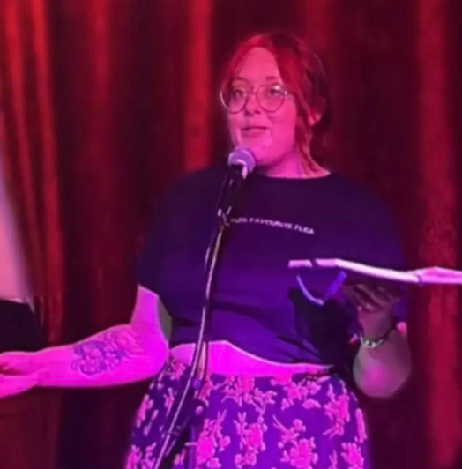

Campus Council
School Reps will be part of their Campus’ Council.
This will involve meeting regularly with the Campus Officer to work on campaigns, form policies, and decide on campus stances.
You will receive full training on this from the Democracy Development Coordinator.
Active members of the Campus Council will also have the chance to be part of the Union Executive, the top decision-making body of the Union.

Slide 10

What is a campaign?
A campaign is where students organise to improve conditions at the university, or in their local community, on a wide variety of issues, be that in academics like getting class sizes reduced, or tackling social issues which exist across society like racism.
Notes:
Some feedback can lead to more substantial societal change. This can mean you have a campaign idea:
WHAT IS A CAMPAIGN?
A campaign is where students organise to improve conditions at the university, or in their local community, on a wide variety of issues, be that in academics like getting class sizes reduced, or tackling social issues which exist across society like racism.

Slide 11
Does campaigning work?
Absolutely, at ARU and across the UK, students have won…
Class size reductions from 400 to 100 students in FBL
Keeping Wednesday Afternoon Free for undergraduates
Reintroduction of maintenance grants
And much more
Notes:
Some feedback can lead to more substantial societal change. This can mean you have a campaign idea:
WHAT IS A CAMPAIGN?
A campaign is where students organise to improve conditions at the university, or in their local community, on a wide variety of issues, be that in academics like getting class sizes reduced, or tackling social issues which exist across society like racism.

Slide 12

Your Liberation & Campaigns Coordinator – Jo Bunkle
The Union’s Liberation & Campaigns Coordinator is there to give you advice, boost your confidence and expand your horizons as an activist.
Jo has been working with student campaigners for years, and has insight into making change in, and outside ARU.
Jo Bunkle
Campaigns Coordinator
She/They
j.bunkle@angliastudent.com
Notes:
Some feedback can lead to more substantial societal change. This can mean you have a campaign idea:
WHAT IS A CAMPAIGN?
A campaign is where students organise to improve conditions at the university, or in their local community, on a wide variety of issues, be that in academics like getting class sizes reduced, or tackling social issues which exist across society like racism.

Slide 13
Other opportunities...
As a school rep you will also have access to the following:
Course Approval Panels
Academic Misconduct Panels
Take part in forums and surveys from both the uni and the union
Run an event or project with our Make It Happen team https://arunion.co.uk/chelmsford/your-say/makeithappen/
Campaigning
Join or start a course based society. https://arunion.co.uk/chelmsford/get-involved/societies/
These opportunities are awarded in a variety of ways and will come to your emails so read them!
Notes:
Don’t forget to give examples!

Slide 14

Volunteering hours
As a school rep you are a volunteer for the Union and whilst completing your duties as a rep and any extra opportunities you may take on, you will accumulate some volunteering hours.
You should log these hours on our volunteering portal: https://arunion.co.uk/chelmsford/get-involved/volunteering/log-hours/
Through this you can generate a transcript of all the hours you spent as a course rep which you can use for portfolio’s, applications, or your CV.
These hours are carried over throughout all your years at university and once you hit a milestone you can also ask to generate a certificate. 75 hours gets you a Bronze certificate, 150 for Silver, 250 for Gold and 400 for Platinum.
You can also log this hour of training on there, so don’t forget to do so after this session!

Slide 15
Congratulations on finishing training: What's Next?
Introduce yourself to your course reps
Collect your school rep lanyard
Put your digital school rep badge in your email signature
Check out the Rep Hub on the Student Union website https://arunion.co.uk/chelmsford/your-say/representation/
Log your volunteer hour for this session

